Slide 1
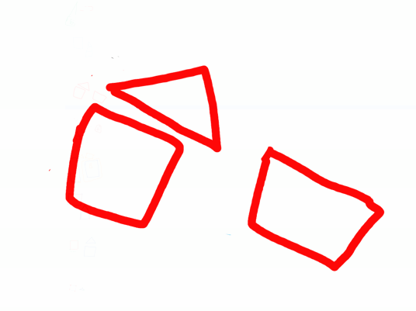
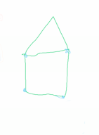
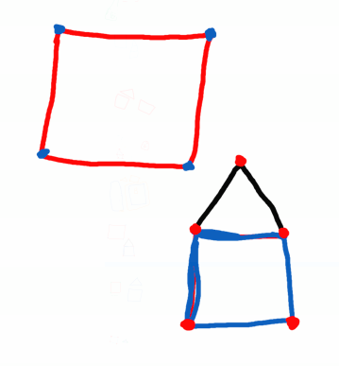
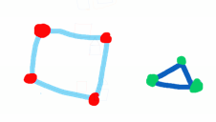
Polygon Lessons
September 2-12
1st and 2nd grade
Instructions: Draw a picture of the polygons you create with your Building Set.

Slide 2
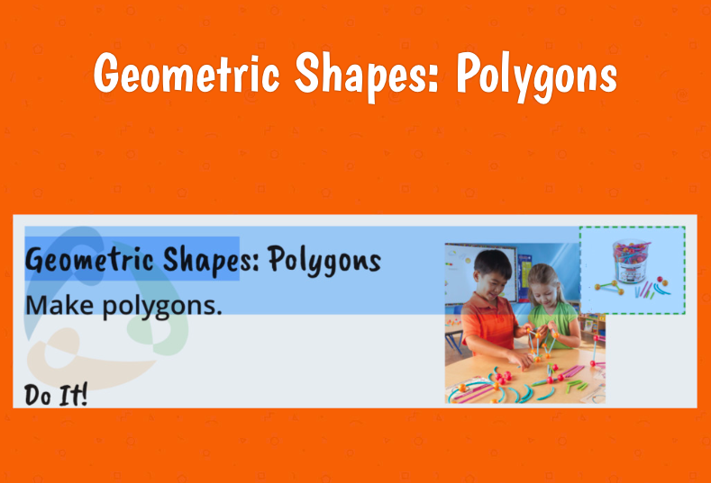
Tuesday, September 10
Mrs. Edwards’ Class

Slide 3
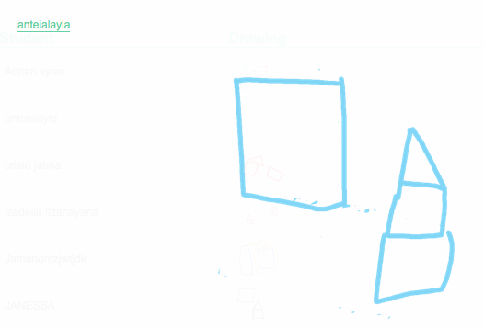
Cristo and Jabria
Anteia and Layla

Slide 4
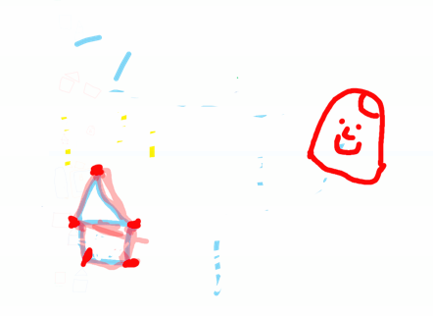
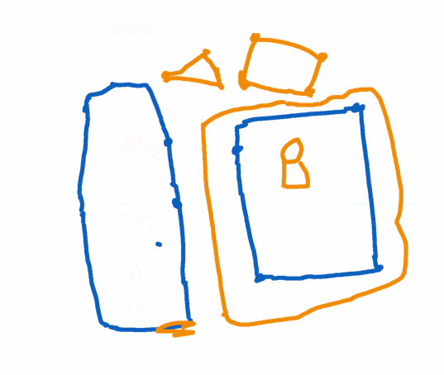
Izabella and Itzana
Jamarion and ?

Slide 5
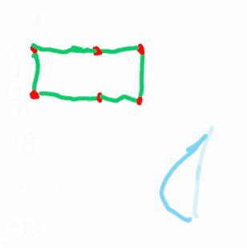
Yazmin and Lymon
Noel and Almir

Slide 6
Janessa
Leslie and Mekhi

Slide 7
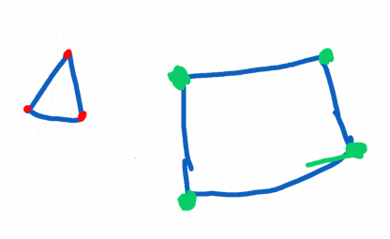
Maya and Omar

Slide 8
Thursday, September 12
Ms. Graumann – Grade 2

Slide 9
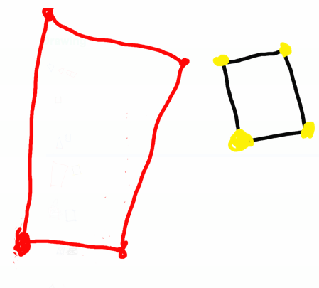
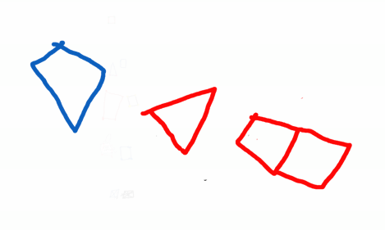
Jaelynne and Brai
Damayja and Dain

Slide 10
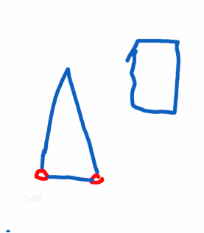
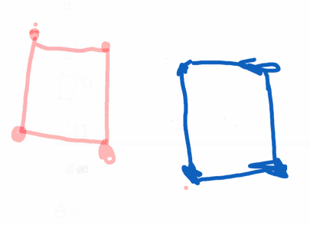
Jacoby
Janae and Boone

Slide 11
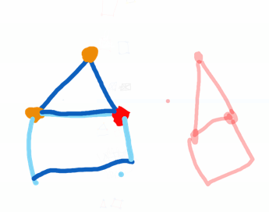

John and Aiden
Jordyn and Janaya

Slide 12
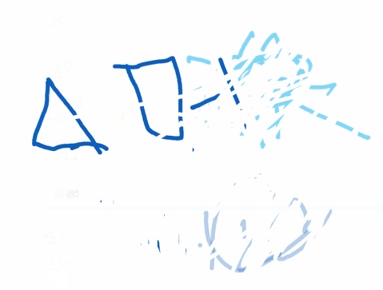
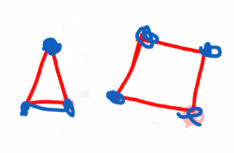
Juliyah and Travis
Kaidence and Angel

Slide 13
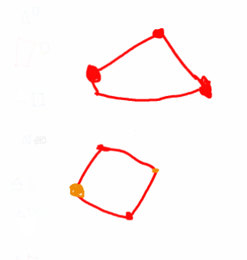
Kamia and Treazure

Slide 14
Thursday September 12
Mrs. Gonzalez – Grade 2

Slide 15
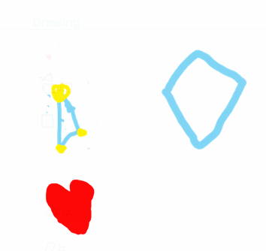
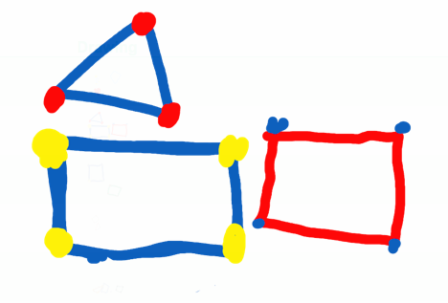
Anarsa and Genisis
Angel and Franklin

Slide 16
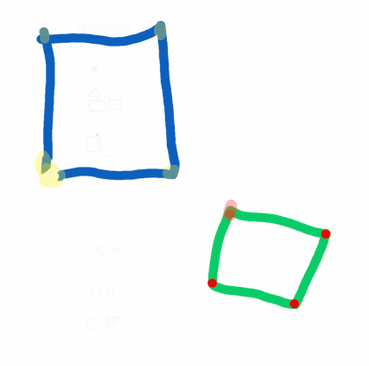
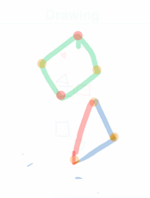
Axel and Giovanny
Brianna and Allison

Slide 17
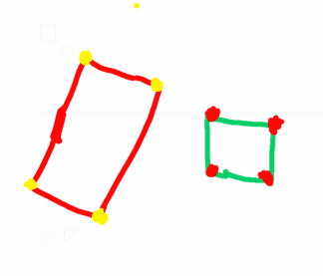
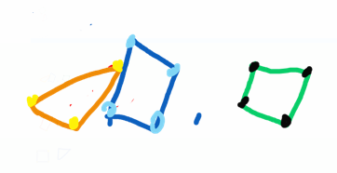
Gael
Jennifer and Rosa

Slide 18
Thursday, September 12
Eaves – Grade 2

Slide 19
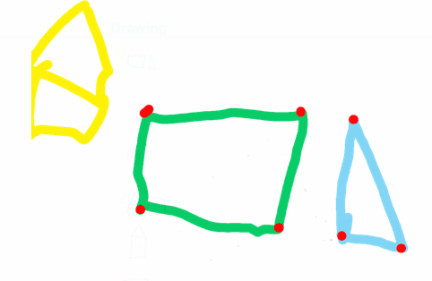
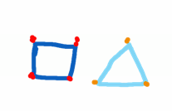
Amaire and Tramelle
Angelique and Marveya

Slide 20
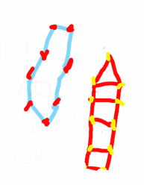
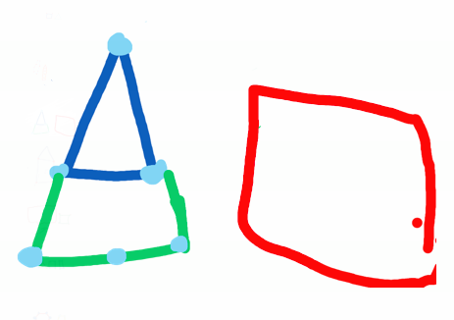
Jaden and Antwan
Janell and Amiya

Slide 21
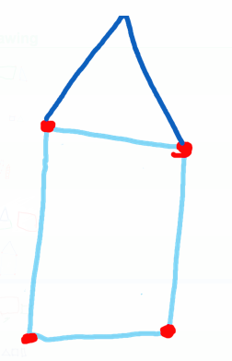
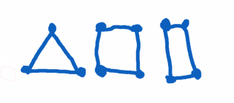
Janiyah and Dalilyah
Jesus and Jordan

Slide 22
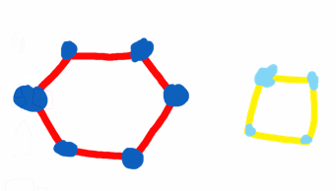
Antorrese and Joyce

Slide 23
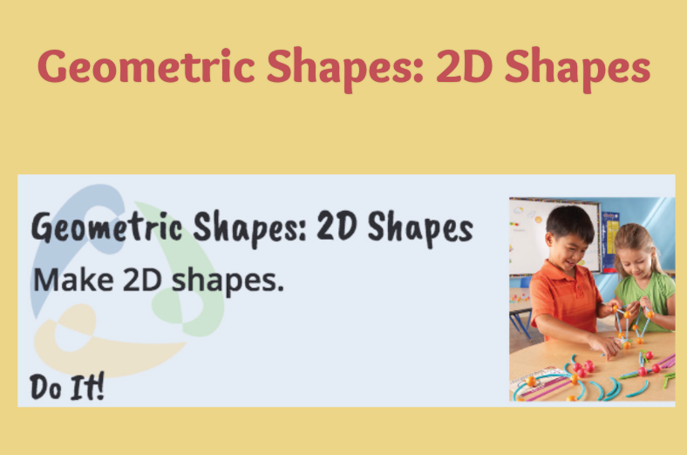
Tuesday, September 17
Mrs. Geraghty’s Class

Slide 24
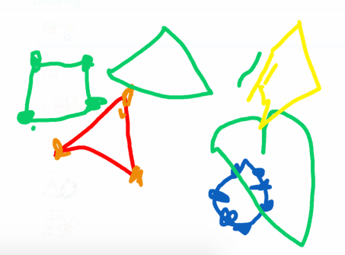
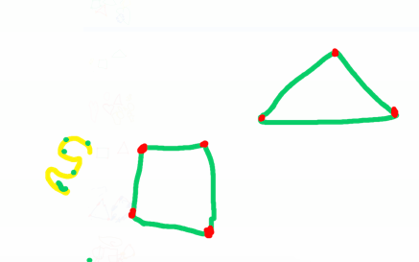
Jerale and Kevion
Jeremiah and Daniel

Slide 25
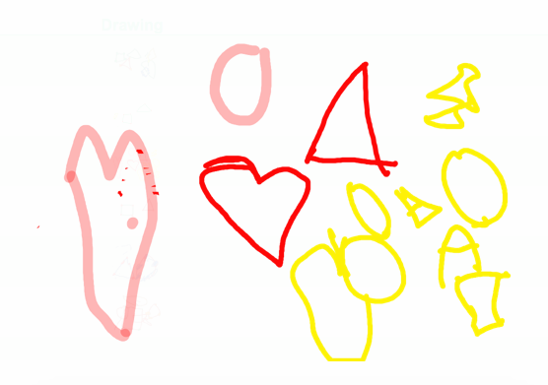
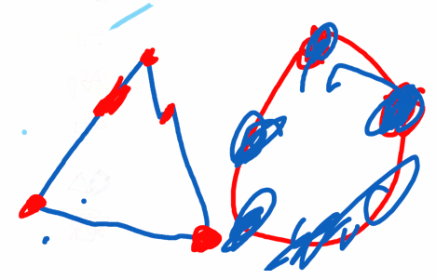
Jaidy and Kendall
Kanye and Johnnie

Slide 26
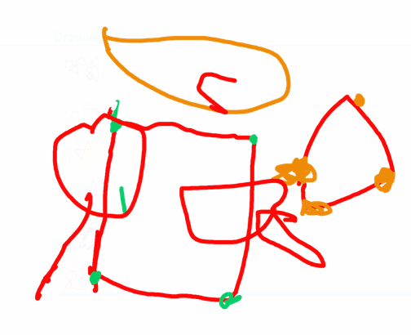
London

Slide 27
Tuesday, September 2
Mixed Classes

Slide 28
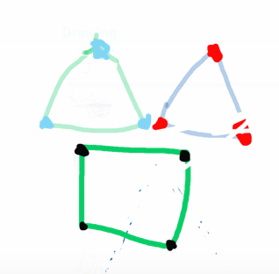
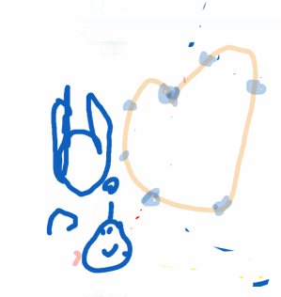
Abigail and Daniel
Angelo

Slide 29
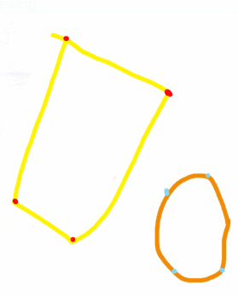
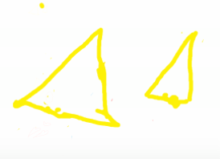
Clifford and Kristen
Jazriah

Slide 30

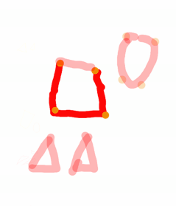
Queen and Nadir
William and Morgan

Slide 31
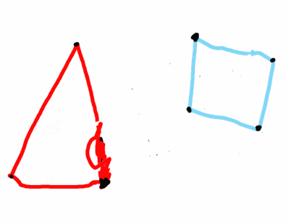
Yahir and Julius

Slide 32

GREAT JOB, STEAMERS

