Slide 1
ABCs of Notable
Hispanic People
Created by ESL Students at Washington School
Ms. White’s Library Class
October 2009
Click to advance slides

Slide 2
The students chose the topic and the people for this project.
The information for Hispanic Amercans came from Infoplease.
https://www.infoplease.com/biographies/notable-hispanic-americans-z#l
The information about the other notable Hispanics came from Wikipedia.

Slide 3

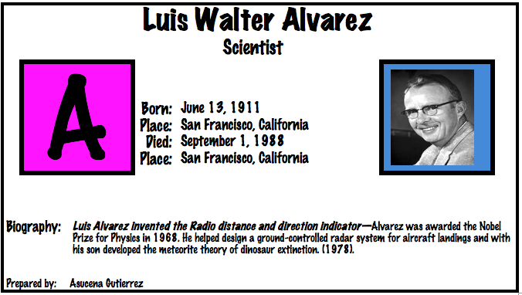

Slide 4
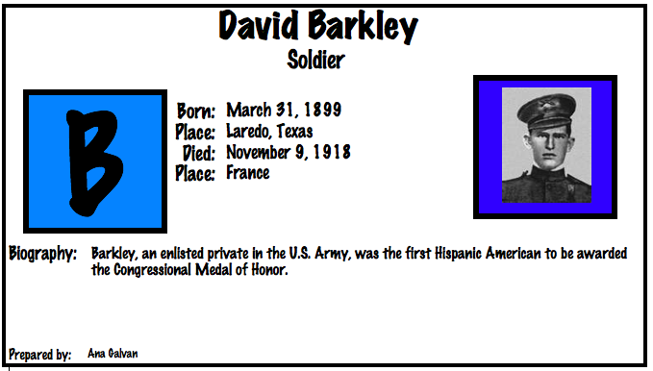

Slide 5
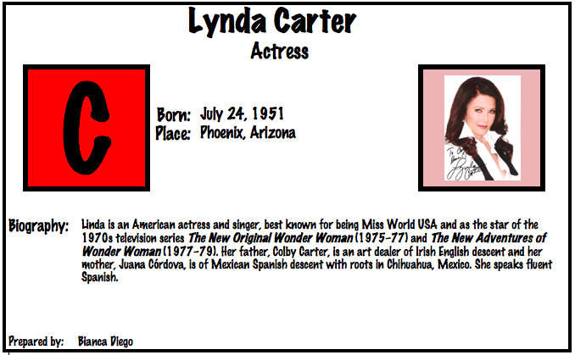

Slide 6
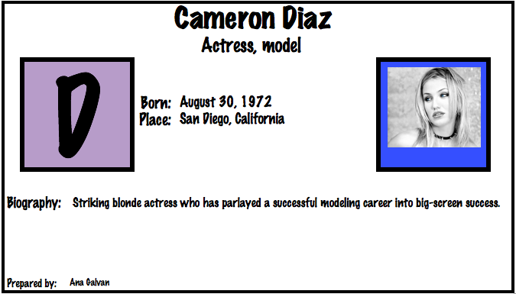

Slide 7
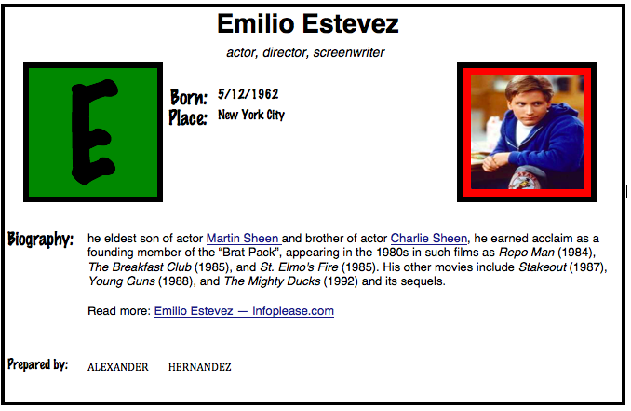

Slide 8
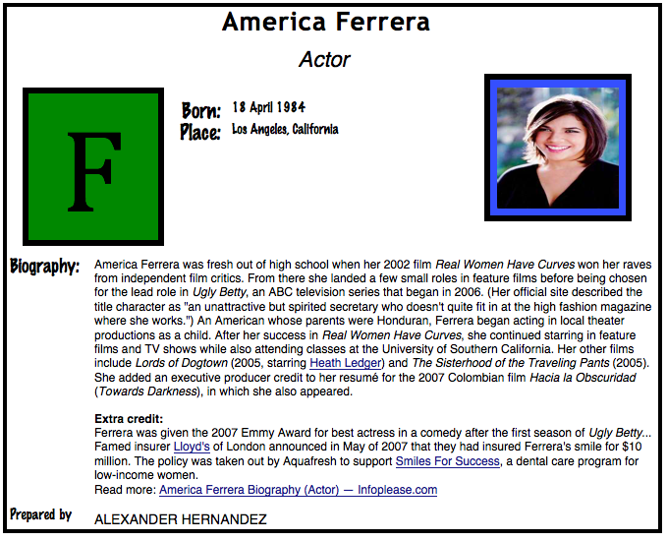

Slide 9
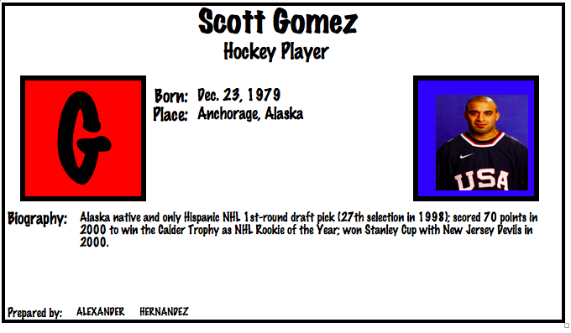

Slide 10
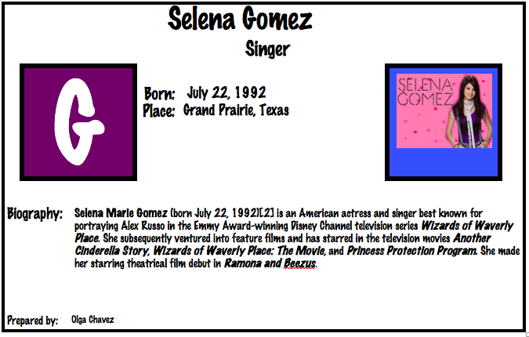

Slide 11
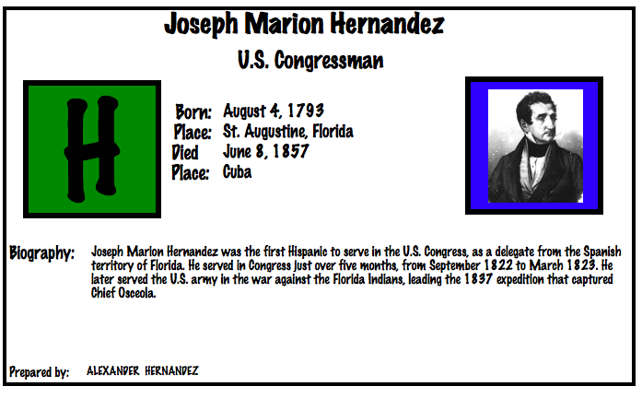

Slide 12
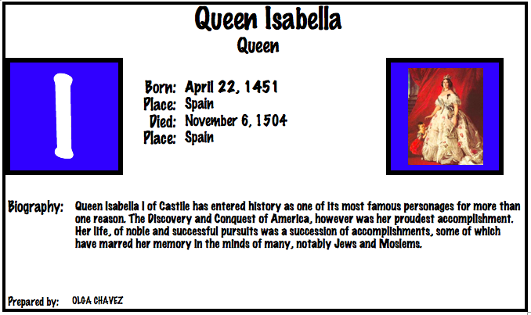

Slide 13
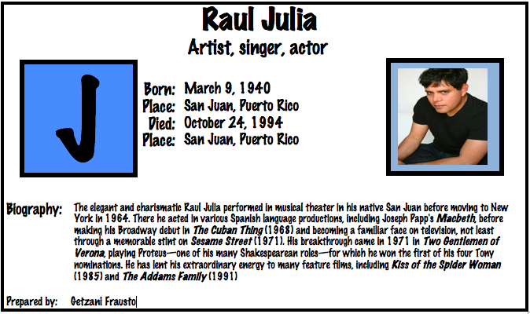

Slide 14
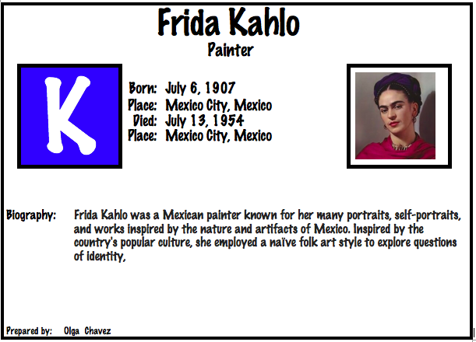

Slide 15
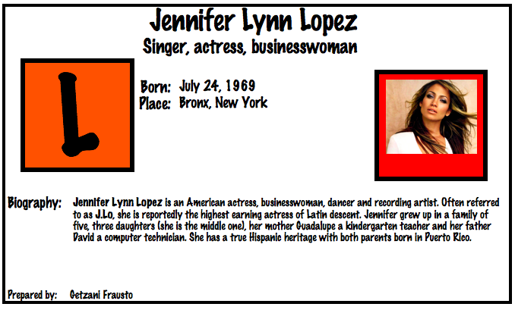

Slide 16
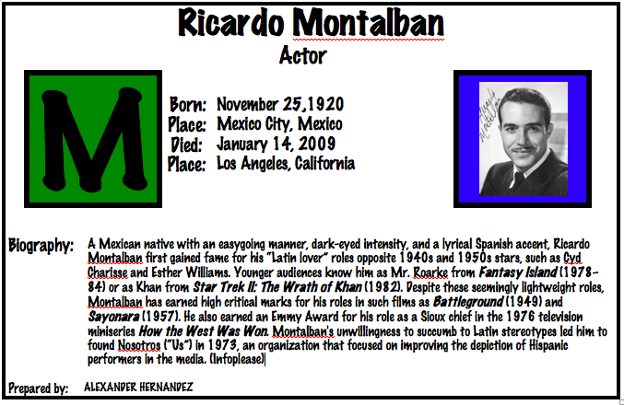

Slide 17
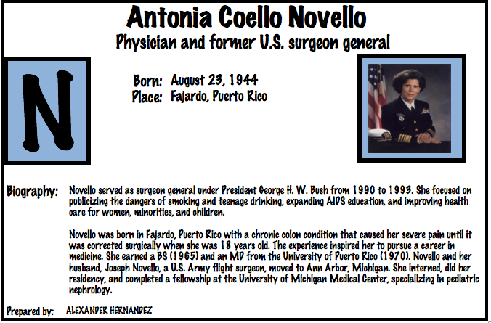

Slide 18
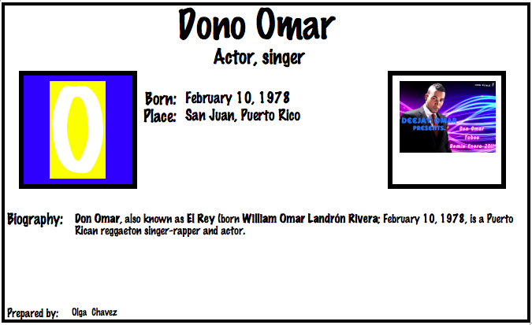

Slide 19
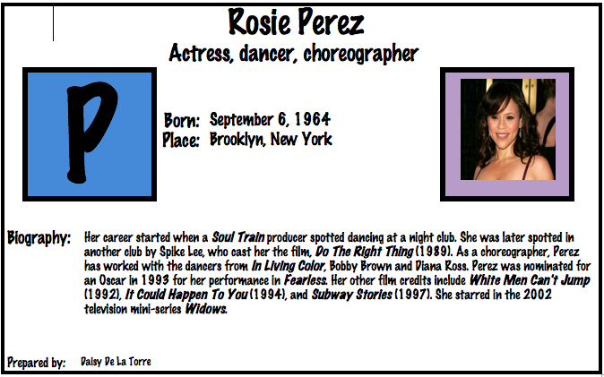

Slide 20
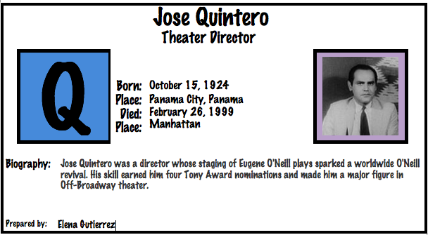

Slide 21
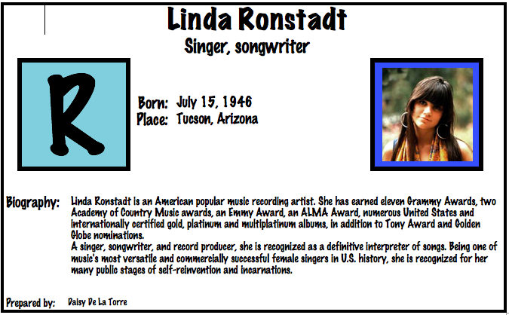

Slide 22
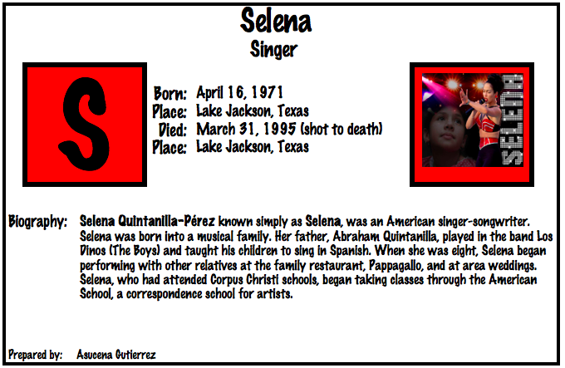

Slide 23
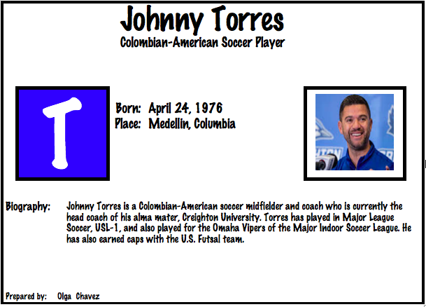

Slide 24
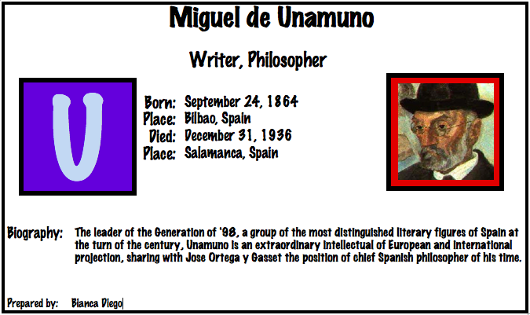

Slide 25
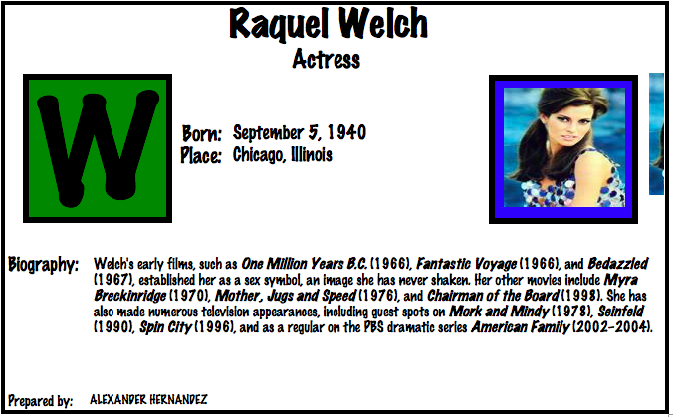

Slide 26
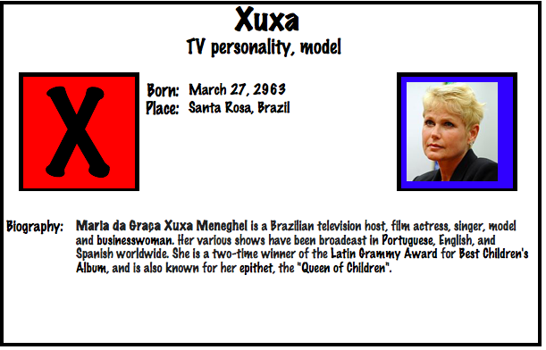

Slide 27
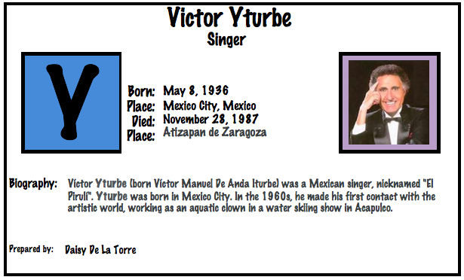

Slide 28
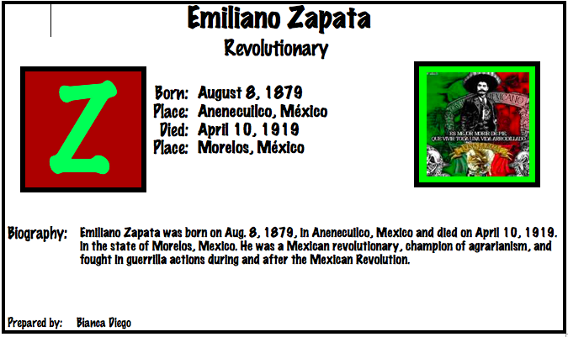

Slide 29
The End
Special thanks to the ESL students, Grades 2-5 who put together these slides over 10 years ago. Just like most treasures I happened to find them accidentally. The slides wereformatted to fit this PowerPoint presentation.
~Ms. J. White

