Slide 1

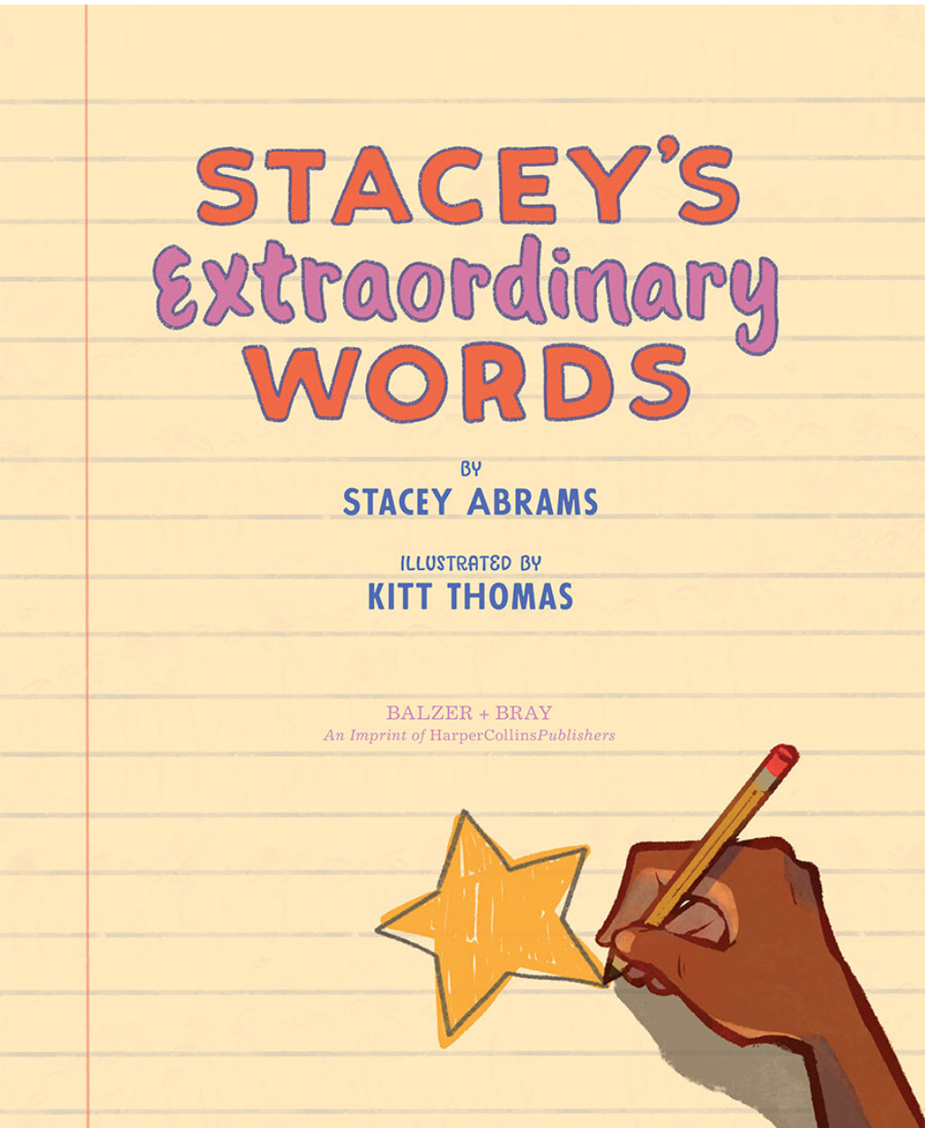
Click here to go to the next page.

Slide 2
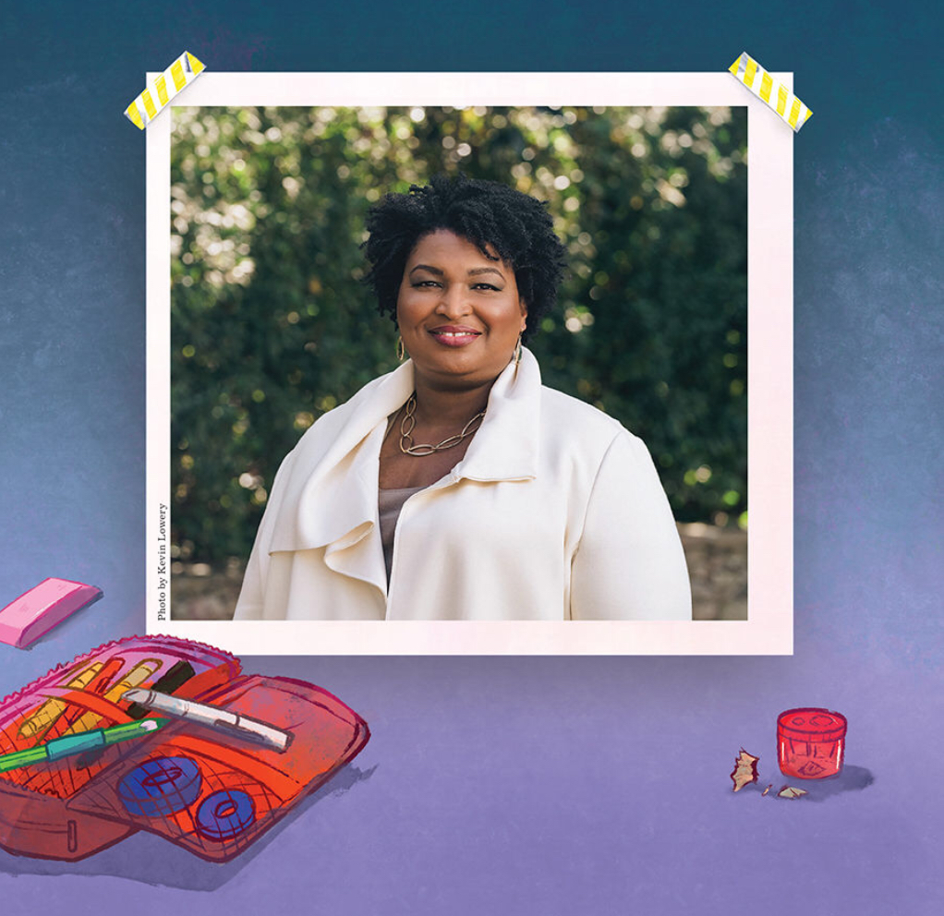

On the next slides, you can learn the words in Stacey’s notebook. Click on the to listen to each word and the definition.
Click on this icon to advance to the
next slide each time.

Slide 3

anxious (ang-shus): filled with worry
awkward (aa-kward): lacking in confidence or skill
blunder (bluhn-dur): a mistake
bright (brite): giving off lots of light

Slide 4
chocolate (chaa-kluht): a yummy dessert
Remember the second “o”!
clambering (klam-bur-eeng): using your hands and feet to climb a difficult path
complicated (kaam-pluh-kay-tuhd): including many parts
conquered (kaan-kurd):took control by force

Slide 5
courteous (kur-tee-uhs): to treat others with kindness and respect
craggy (kra-gee): rough or uneven
cruel (krooel): when someone is mean on purpose
defeated (duh-fee-tuhd): won in a competition Weirdly, it can also mean losing.

Slide 6
disengage (di-suhn-gayj): to release or separate from something
dither (di-thur): to be unsure
duckling (duh-kluhng): a baby duck
enormous (uh-nor-muhs): very large

Slide 7
evaporated (uh-va-pur-ay-tuhd): to disappear into the air
except (uhk-sept): not including Not to be mixed up with accept, where you do receive something!
geometry (jee-aa-muh-tree): a type of math that measures the surface of shapes
grumpy (gruhm-pee): in a bad mood

Slide 8
instantaneous (in-stuhn-tay-nee-uhs): when something happens immediately Don’t give up if doesn’t. Most things take time and lots of practice.
intimidated (in-ti-muh-day-tuhd): not confident in yourself
monotonous (muh-naa-tuh-nuhs): when something stays the same
onomatopoeia (aa-nuh-maa-tuh-pee-uh): a word to describe the sounds of other words

Slide 9
perseverance (pur-suh-vee-ruhns): always willing to try again and never give up One of my favorite words!
persnickety (pur-sni-kuh-tee): to be very particular about things
petrified (peh-truh-fide): really, really afraid It can also mean when something is converted into stone.
promptly (praampt-lee): when something happens very quickly

Slide 10

ptarmigan (taar-muh-gin): a bird that lives in cold, northern regions Remember the ‘p’ is sllent!
reception (ruh-sep-shun): an event where you welcome someone It can also mean when you receive something—like a reaction.
sesquipedalian (seh-skwuh-puh-day-lee-uhn): a word with a lot of syllables
shudder (shuh-dur): to shiver or shake

Slide 11
sluggish (sluh-guhsh): very slow
stupendous (stoo-pen-duhs): another word for amazing
squeezed (skweezed): held too tight Remember the lost letters like “q” and “z”.
tackled (ta-kuhld): worked hard to deal with a difficult task

Slide 12
torturous (tor-tschur-us): very unpleasant or painful
transportation (tran-spor-tay-shun): a way to get from one place to another
village (vi-luhj): a place smaller than a town, where people live together
whisk (wisk): to move quickly

Slide 13
The
End

