Slide 1
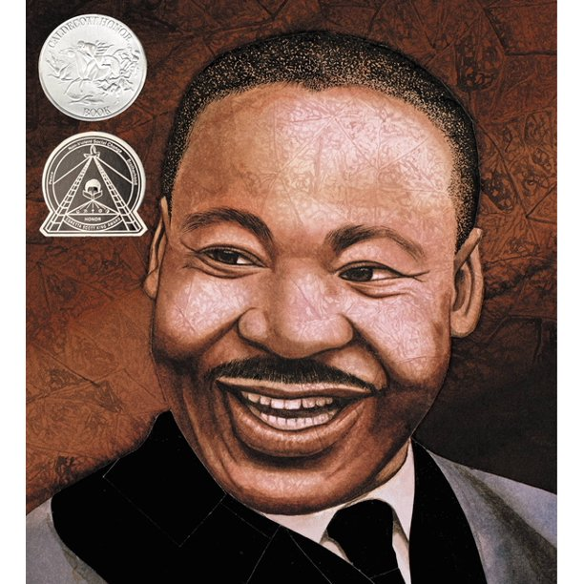
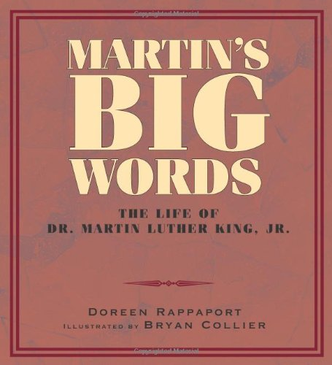
Click here to go to the next page.

Slide 2
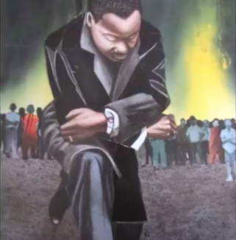

On the next slides, you can learn vocabulary from Martin’s Big Words. Click on the to listen to each word and the definition.
Click on this icon to advance to the
next slide each time.

Slide 3
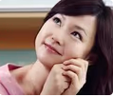

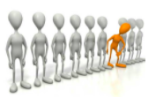
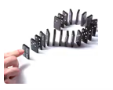
Martin’s BIG Words
admire: to like and respect someone
individual: one person or one thing
influence: to affect what someone thinks or does

Slide 4
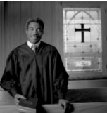
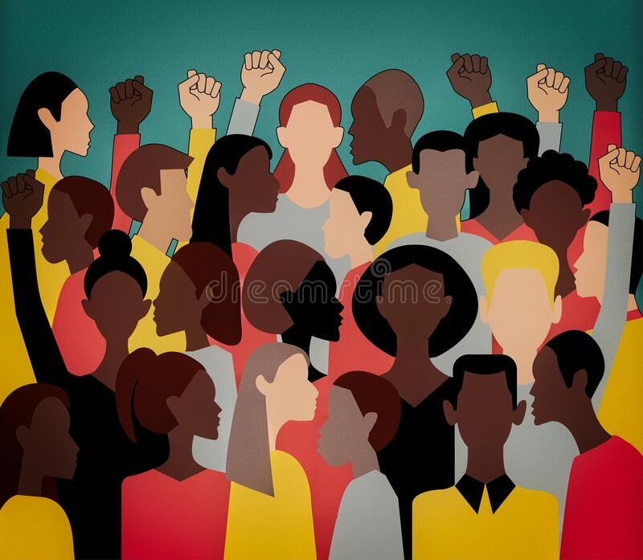
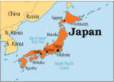
Martin’s BIG Words
minister: a person who performs religious functions in a church
movement: a group of people working to make change
nation: a country with its own government

Slide 5
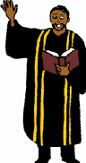
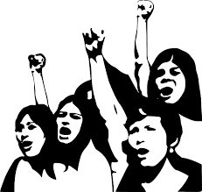

Martin’s BIG Words
preach: to urge people to believe something
protest: to complain or argue against
segregation: separation

Slide 6
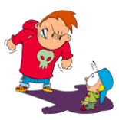
Martin’s BIG Words
threaten: to scare or intimidate someone
The
End

