Slide 1
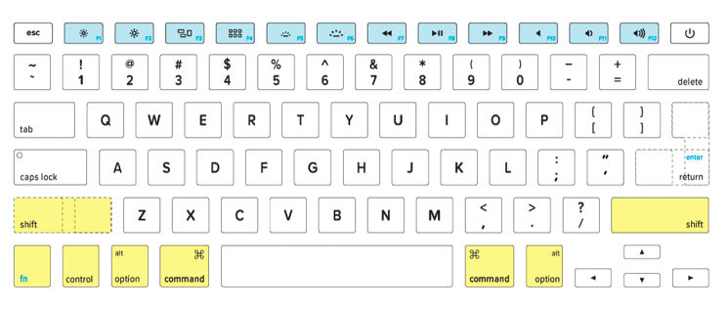
Qwerty Keyboard Alphabet Song
MAC keyboard

Slide 2
Q
q

Slide 3
W
w

Slide 4
E
e

Slide 5
R
r

Slide 6
T
t

Slide 7
Y
y

Slide 8
U
u

Slide 9
I
i

Slide 10
O
o

Slide 11
P
p

Slide 12
A
a

Slide 13
S
s

Slide 14
D
d

Slide 15
F
f

Slide 16
G
g

Slide 17
H
h

Slide 18
J
j

Slide 19
K
k

Slide 20
L
l

Slide 21
Z
z

Slide 22
X
x

Slide 23
C
c

Slide 24
V
v

Slide 25
B
b

Slide 26
N
n

Slide 27
M
m

Slide 28
now you know
the qwerty
keys

Slide 29
texting

Slide 30
typing

Slide 31
1

Slide 32
2

Slide 33
3

Slide 34
It’s like

Slide 35
learning

Slide 36
Aa

Slide 37
Bb

Slide 38
Cc

