Slide 1
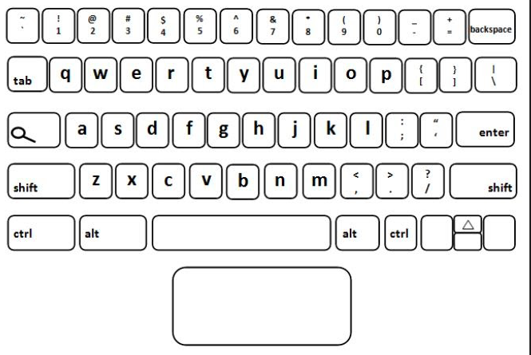
qwerty Keyboard Alphabet Song
Chrome Keyboard

Slide 2
q
Q

Slide 3
w
W

Slide 4
e
E

Slide 5
r
R

Slide 6
t
T

Slide 7
y
Y

Slide 8
u
U

Slide 9
i
I

Slide 10
o
O

Slide 11
p
P

Slide 12
a
A

Slide 13
s
S

Slide 14
d
D

Slide 15
f
F

Slide 16
g
G

Slide 17
h
H

Slide 18
j
J

Slide 19
k
K

Slide 20
l
L

Slide 21
z
Z

Slide 22
x
X

Slide 23
c
C

Slide 24
v
V

Slide 25
b
B

Slide 26
n
N

Slide 27
m
M

Slide 28
now you know
the qwerty
keys

Slide 29
texting

Slide 30
typing

Slide 31
1

Slide 32
2

Slide 33
3

Slide 34
It’s like

Slide 35
learning

Slide 36
Aa

Slide 37
Bb

Slide 38
Cc

